Slide 1

CISCO Switch Basic Understanding
Prepared by: Fahad Burhan Ahmad

Slide 2
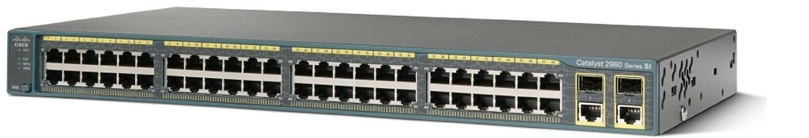

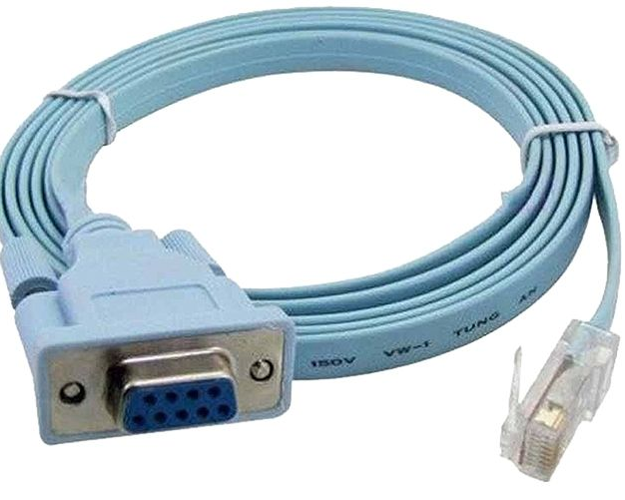
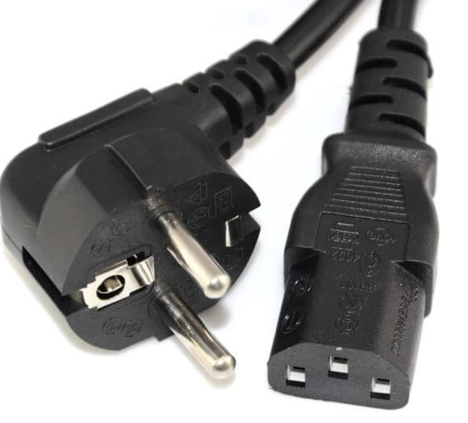
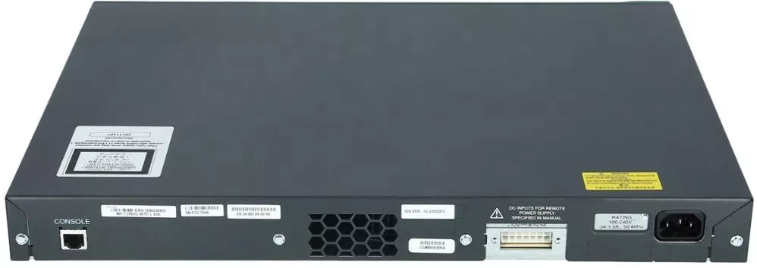
Configuration requirement

Slide 3
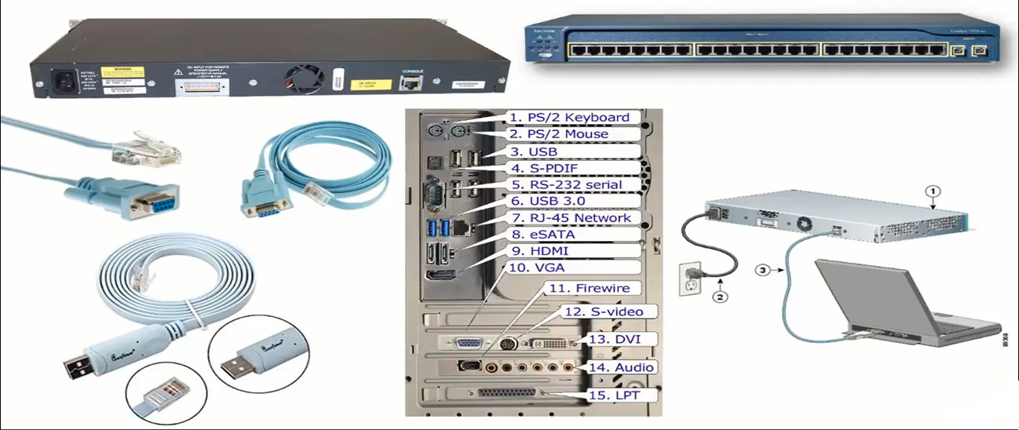
Cables Connectivity

Slide 4
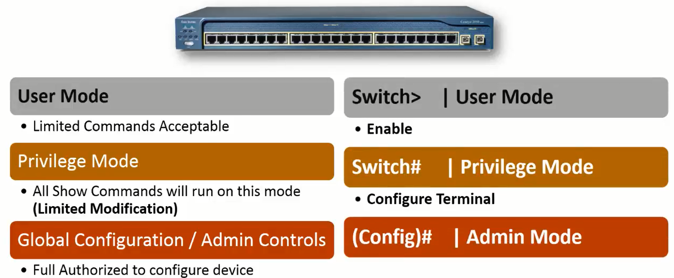
Switch Modes

Slide 5

Thank You
Repeat the slides until you learn

